Slide 1
Mediating with LIRA
This is based on Litigation Interest and Risk Assessment: Help Your Clients Make Good Litigation Decisions by Michaela Keet, Heather Heavin, and John Lande. Copyright 2020 American Bar Association.

Slide 2
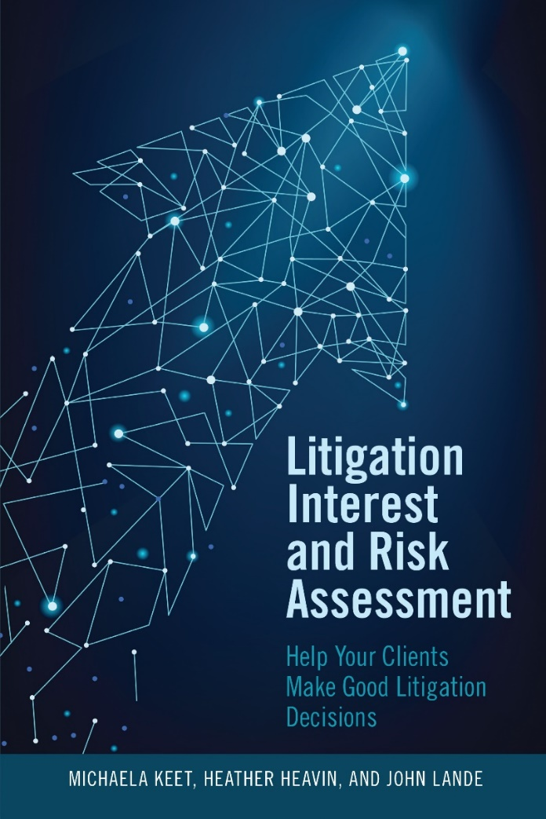
Litigation Interest and Risk Assessment

Slide 3
Background
Book is practical guide with lots of checklists in appendixes.
It combines research on risk assessment and early dispute resolution.
Although much is directed to advocates, it includes material specifically for mediators.
For description of book and link to order, go to tinyurl.com/ybc5ou68.

Slide 4
Agenda
Three-part litigation interest and risk assessment (LIRA) structure
Process you can use in mediations
Potential to take advantage of these techniques in online environment

Slide 5
LIRA Goals
Improve party decision-making
Fulfill fundamental professional ethical obligation of lawyers and mediators
Improve results for parties, courts, and society by:
Reducing decision errors in going to trial after rejecting good settlement offer
Reducing tangible and intangible costs of litigation

Slide 6
Causes of Bad Decisions
Cognitive and motivational errors such as anchoring, self-serving bias, confirmation bias, hindsight bias, reactive devaluation, sunk cost bias, partisan role bias
Dynamics of lawyer-client relationship producing “conspiracy of optimism” and “prison of fear” inhibiting candid assessment
Reluctance of lawyers to communicate clearly and specifically about litigation risks

Slide 7
Benefits of LIRA Process
Mediators often address elements of litigation but not as systematically as LIRA process, which:
Explicitly focuses on intangible costs, which often are overlooked or undervalued
Provides logical sequence to enhance party decision-making
Enables practitioners to adapt process to their philosophies and needs of particular parties

Slide 8
Mediators’ Use of LIRA
Mediators using LIRA process can help parties:
Do their own LIRAs
Identify key legal and factual uncertainties and possible outcomes to estimate BATNAs and develop bottom lines
Explicitly consider tangible and intangible costs
Develop wise and effective mediation strategies

Slide 9
Three Elements of LIRA
Expected value of court outcome (aka BATNA)
Tangible costs of continuing to litigate
Intangible costs of continuing to litigate
Note that LIRA process:
Can be used in pre-suit mediation
Generally focuses on monetary disputes – and can include non-monetary issues
Focuses on future costs, not past (sunk) costs

Slide 10
1. Potentially Unfavorable Court Outcome
Litigation can provide substantial benefits to parties and society . . .
. . . but litigation is inherently risky and parties may get unfavorable court decisions.
Parties’ expectations about court outcome often are major factors in mediation.

Slide 11
2. Tangible Costs
Litigation imposes tangible costs including:
Legal fees for represented parties
Legal expenses for discovery, experts etc.

Slide 12
3. Intangible Costs
Being a party in litigation imposes many intangible costs on parties such as:
Stress causing physical and psychological harm
Being stuck in dispute, not getting on with life
Damaged relationships
Harm to reputations
Loss of opportunities

Slide 13
Importance of Intangible Costs
Intangible costs are very important to parties, sometimes more important than the court outcome.
People often ignore or undervalue intangible costs, which reflect parties’ interests.
You can help parties identify and value intangible costs by asking how much it would be worth to avoid delay, risk, stress etc. of going to trial.
Considering value of intangible costs may reduce expectations for monetary outcome, making it easier to settle.

Slide 14
Mediating with LIRA
Use key mediation skills of asking good questions and listening carefully.
Figure out what dispute really is about – with parties and lawyers (often in caucus).
Don’t assume that dispute is about correct interpretation of facts or law. It may be. But it may be about other sources of conflict.

Slide 15
Common Sources of Conflict
Personality conflicts
Underlying conflicts
Large stakes
Inexperienced lawyers
Fear of looking weak
Parties don’t know or trust each other
Parties don’t know the case yet
Poor communication, including with clients, counsel
Unrealistic expectations about trial outcome
Concern about setting precedent
Lawyers want to fight, perform for clients, increase fees

Slide 16
Mediator as Conflict Diagnostician
Start (in caucus) by asking open questions such as “What is most important to you in this case?“ “Why haven’t parties settled so far?”
Parties generally want favorable financial result – but they vary in what they define as favorable (or acceptable).
Parties often want other things, which may be as or more important than financial outcome.
Other goals include being treated with respect, good relationships, favorable precedent, apologies, future employment, or recommendation.

Slide 17
Understanding the Other Side
Ask what they think are other side’s perspectives and goals.
Then ask if they think any of their perspectives or goals are justified.
Follow up by asking if this affects their assessment of likely court outcome.
Ask what might persuade other side to change their assessment.

Slide 18
Ask How Case Has Affected Them So Far
This can be a good, indirect way of finding out their interests.
Generally, they will complain.
Settling provides an opportunity for them to “stop hitting their head against the wall” – because it feels so good when they stop.

Slide 19
Discussing Intangible Costs
Mediators discuss intangible costs in many ways, such as:
Asking: “Earlier, you said relationships were important to you. How would going to trial affect your relationships?”
Coaching: “When I see people late in litigation, they often say it has taken a toll on them.”
Delegating: “Please discuss with your lawyer [or other advisor] how going to trial may affect you.”
Telling: “Going to trial is likely to hurt your reputation and keep you from doing things you want to do.”

Slide 20
Tangible Costs of Litigation
Ask how much they spent so far in litigation costs.
Then ask how much more they expect to spend if they go to trial.
They may not have exact figures. Round numbers are fine.

Slide 21
Help Them Assess Likely Trial Outcome
Generally do this after asking about their interests.
They may be confident they can persuade court about some factual, legal, or remedies issues – and less certain about others.
Ask which issues they might lose.
Ask how they would rebut other side’s arguments.
Ask what is realistic probability that court would find in their favor on those issues.

Slide 22
Discussing Trial Risks
Mediators discuss trial risks in many ways, such as:
Facilitating: “What’s your sense of the probability that you can prove X (e.g., breach of duty) at trial?”
Coaching: “In trial, many judges would have questions about X.”
Delegating: “Please discuss with your lawyer the likelihood that you will be able to prove X at trial.”
Telling: “I think that most judges would decide Y about issue X.”

Slide 23
Ask How You Can Be Helpful
Don’t assume that they just want you to agree with them.
They may want:
your candid assessment of their arguments
understanding of the other side’s views
advice in negotiation strategy
help persuading the other side
Bottom line: don’t assume.

Slide 24
Your Assessment of the Case
Mediators differ about whether they give their opinions.
Some mediators give opinions at outset, sometimes without parties’ permission. This is problematic.
If you are willing to give your opinions, ask parties if they want to hear your opinion about any issues.
Parties are more likely to accept your opinions if you first understand the case and they ask for your opinion.
They may not want your opinion and you should respect their wishes.

Slide 25
Developing a Bottom Line
Parties develop bottom lines by adjusting estimated BATNA values by amount of tangible and intangible costs.
Bottom lines are “trip wires” to end mediation if they can’t reach an acceptable agreement.
Bottom lines are major elements of mediation strategies if parties focus on getting a better result than at trial.

Slide 26
Mediator as Dispute System Designer
Mediators generally are DSD designers, orchestrating preparation and exchange of information.
Mediation by video creates greater need and opportunity to design and manage the process.
LIRA provides more and better tools to design process in consultation with lawyers and/or parties.
Planning for optimal decision-making
Accommodating parties’ process needs
Timing and sequence of sessions
Attendance of particular individuals

Slide 27
Planned Early Two-Stage Mediation
There is a common norm of trying to complete mediation in a single session, especially civil mediations.
This can put great pressure on parties to settle before they are ready, especially in marathon mediations.
This can result in buyer’s remorse, reneging, poor performance, complaints against mediators or lawyers.
You can improve process by offering option of two-stage mediation so parties can consider LIRA issues after first session.

Slide 28
Doing PETSMs
If parties settle in first session, they don’t need second session.
If they don’t settle in first session, you can give them “homework” to prepare for second session.
Planning for possibility of a second session gives “permission” to take time to get information, consult others, and reflect on mediation goals and strategy.
Describe process in advance, perhaps on website as well as convening documents.

Slide 29
Planned Early MULTI-Stage Mediations
Mediators can take advantage of virtual mediation process to break mediation into multiple stages during a particular period, such as a week.
Since parties and lawyers aren’t traveling, they don’t have to be together all at one time.
You can schedule caucuses with just one side without “dead time” of other side waiting.
You can plan for authoritative decision-makers to participate for limited times at end of process.

Slide 30
Appendixes
The book includes appendixes relevant for mediators:
Neutrals’ Questions about Litigation Interests and Risks
Neutrals’ Guidance to Help Parties and Lawyers Prepare for Mediation
Self-Care by Practitioners

