Slide 1
Helping Legal Clients Using LIRA Techniques
This is based on Litigation Interest and Risk Assessment: Help Your Clients Make Good Litigation Decisions by Michaela Keet, Heather Heavin, and John Lande. Copyright 2020 American Bar Association.

Slide 2
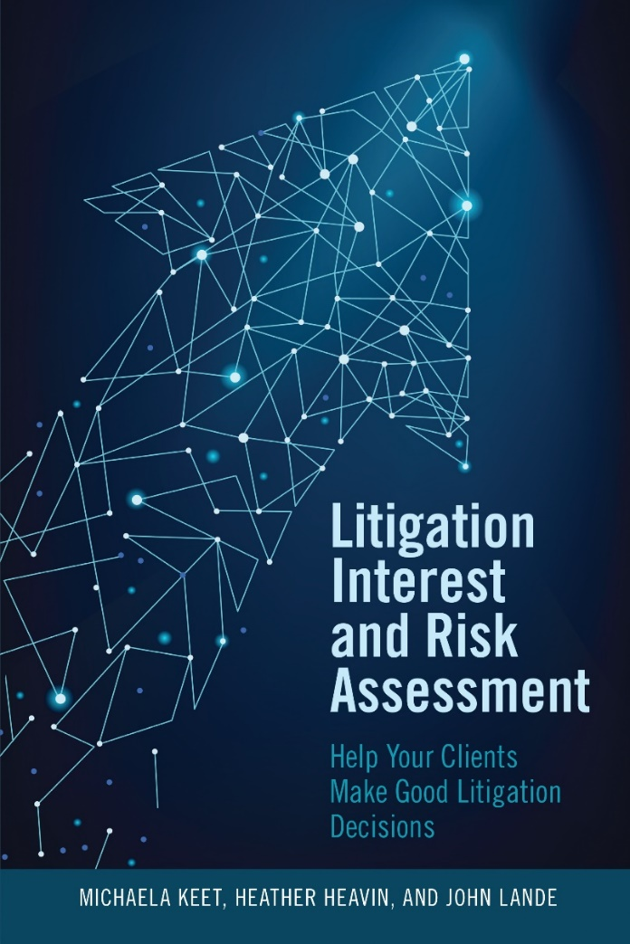
Litigation Interest and Risk Assessment

Slide 3
Background
Book is practical guide with lots of checklists in appendixes.
It combines research on risk assessment and early dispute resolution.
Although much is directed to advocates, it also includes material specifically for mediators.
For description of book and link to order, go to tinyurl.com/ybc5ou68.

Slide 4
Agenda
Three-part litigation interest and risk assessment (LIRA) structure
Process you can use in representing clients
Potential to take advantage of these techniques in online environment

Slide 5
LIRA Goals
Improve party decision-making
Fulfill fundamental professional ethical obligation of lawyers and mediators
Improve results for parties, courts, and society by:
Reducing decision errors in going to trial after rejecting good settlement offer
Reducing tangible and intangible costs of litigation

Slide 6
Causes of Bad Decisions
Cognitive and motivational errors such as anchoring, self-serving bias, confirmation bias, hindsight bias, reactive devaluation, sunk cost bias, partisan role bias
Dynamics of lawyer-client relationship producing “conspiracy of optimism” and “prison of fear” inhibiting candid assessment
Reluctance of lawyers to communicate clearly and specifically about litigation risks

Slide 7
Benefits of LIRA Process
Lawyers often address elements of litigation but not as systematically as LIRA process, which:
Explicitly focuses on intangible costs, which often are overlooked or undervalued
Provides logical sequence to enhance party decision-making
Enables practitioners to adapt process to their philosophies and needs of particular parties

Slide 8
Lawyers’ Use of LIRA
Lawyers using LIRA process can help clients:
Understand their interests and litigation risks
Identify key legal and factual uncertainties and possible outcomes to estimate BATNAs and develop bottom lines
Explicitly consider tangible and intangible costs
Develop wise and effective litigation, negotiation, and mediation strategies

Slide 9
Three Elements of LIRA
Expected value of court outcome (aka BATNA)
Tangible costs of continuing to litigate
Intangible costs of continuing to litigate
Note that LIRA process:
Can and should be used before lawsuits are filed
Generally focuses on monetary disputes – and can include non-monetary issues
Focuses on future costs, not past (sunk) costs

Slide 10
1. Potentially Unfavorable Court Outcome
Litigation can provide substantial benefits to parties and society . . .
. . . but litigation is inherently risky and parties may get unfavorable court decisions.
Parties’ expectations about court outcome often are major factors in mediation.

Slide 11
2. Tangible Costs
Litigation imposes tangible costs including:
Legal fees for represented parties
Legal expenses for discovery, experts etc.

Slide 12
3. Intangible Costs
Being a party in litigation imposes many intangible costs on parties such as:
Stress causing physical and psychological harm
Being stuck in dispute, not getting on with life
Damaged relationships
Harm to reputations
Loss of opportunities

Slide 13
Importance of Intangible Costs
Intangible costs are very important to parties, sometimes more important than the court outcome.
People often ignore or undervalue intangible costs, which reflect parties’ interests.
You can help parties identify and value intangible costs by asking how much it would be worth to avoid delay, risk, stress etc. of going to trial.
Considering value of intangible costs may reduce expectations for monetary outcome, making it easier to settle.

Slide 14
Helping Clients with LIRA
Use key legal skills of asking good questions and listening carefully.
Figure out what the dispute really is about – jointly with the clients.
Don’t assume that dispute is about correct interpretation of facts or law. It may be. But it may be about other sources of conflict.

Slide 15
Common Sources of Conflict
Personality conflicts
Underlying conflicts
Large stakes
Inexperienced lawyers
Fear of looking weak
Parties don’t know or trust each other
Parties don’t know the case yet
Poor communication, including with clients, counsel
Unrealistic expectations about trial outcome
Concern about setting precedent
Lawyers want to fight, perform for clients, increase fees

Slide 16
Lawyer as Conflict Diagnostician
Ask open questions such as “What is most important to you in this case?“ “Why haven’t parties settled so far?”
Parties generally want favorable financial result – but they vary in what they define as favorable (or acceptable).
Parties often want other things, which may be as or more important than financial outcome.
Other goals include being treated with respect, good relationships, favorable precedent, apologies, future employment, or recommendation.

Slide 17
Understanding the Other Side
Ask what they think are other side’s perspectives and goals.
Then ask if they think any of their perspectives or goals are justified.
Follow up by asking if this affects their assessment of likely court outcome.
Ask what might persuade other side to change their assessment.

Slide 18
Ask How the Case Has Affected Them So Far
This can be a good, indirect way of finding out their interests.
Generally, they will complain.
Settling provides an opportunity for them to “stop hitting their head against the wall” – because it feels so good when they stop.

Slide 19
Discussing Intangible Costs
Lawyers discuss intangible costs in many ways, such as:
Asking: “Earlier, you said relationships were important to you. How would going to trial affect your relationships?”
Coaching: “When I see people late in litigation, they often say it has taken a toll on them.”
Delegating: “Please discuss with your spouse [or other advisor] how going to trial may affect you.”
Telling: “Going to trial is likely to hurt your reputation and keep you from doing things you want to do.”

Slide 20
Tangible Costs of Litigation
Discuss how much they spent so far in litigation fees and costs ...
… and estimate how much more they probably would spend to go to trial.
You won’t have exact figures. Round numbers are fine.

Slide 21
Assess Likely Trial Outcome
Do this after asking about their interests.
Tell clients that research shows that in most trials, one party is unrealistic and gets worse result than in settlement.
Ask if they want realistic assessment.
You may be confident you can persuade the court about some issues and less certain about others.
Discuss issues you might lose and how you would rebut the arguments.
Provide realistic range of probabilities that the court would find in their favor on uncertain issues.

Slide 22
Discussing Trial Risks
Lawyers discuss trial risks in many ways, such as:
Identifying risks: “In trial, many judges would have questions about X.”
Quantifying risks: “I think that the odds are 2 to 1 that the judge would decide Y about issue X.”
Predicting outcome: “I think that most judges would decide Y about issue X.”

Slide 23
Ask How You Can Be Helpful
Don’t assume that they just want you to agree with them.
They may want:
your candid assessment of likely court outcome
understanding of the other side’s views
advice about litigation or negotiation strategy
Bottom line: don’t assume.

Slide 24
Expected Value of Court Outcome
Lots of ways that lawyers estimate BATNA:
Experience with similar cases, noting similarities and differences
Legal research about similar cases
Consulting with other lawyers
Decision trees
“Big data” and artificial intelligence tools
Choice of method depends on many factors including amount at stake, experience, client preferences.

Slide 25
Simple Framework
The book provides framework using decision tree logic for estimating mathematical value of BATNA
Combines process into a few steps
Systematically identifies substantial risks of adverse conclusions about legal and factual issues
Estimates likelihood of outcomes of various issues
Explicitly includes tangible and intangible costs to generate “bottom line” for settlement
Can use different assumptions to develop range of likely court outcomes.

Slide 26
Steps in Simple Framework
Stage One: Estimate BATNA
Step 1: Estimate risks regarding liability
Step 2: Estimate damages
Step 3: Determine BATNA: Multiply step 1 by step 2
Stage Two: Calculate Bottom Line
Step 4: Estimate Tangible and Intangible Costs
Step 5: Calculate bottom line: Deduct Step 4 from Step 3

Slide 27
Developing a Bottom Line
Develop bottom line by adjusting estimated BATNA values by amount of tangible and intangible costs.
Bottom lines are “trip wires” to end negotiation if parties can’t reach an acceptable agreement.
Bottom lines are major elements of negotiation strategies if parties focus on getting a better result than in trial.

Slide 28
Lawyer as Dispute System Designer
Lawyers generally are DSD designers, orchestrating preparation and exchange of information.
LIRA provides more and better tools to design process.
Planning for optimal decision-making
Accommodating parties’ process needs
Timing and sequence of process
Using mediation or other dispute resolution processes when appropriate

Slide 29
Consider Mediation
Sometimes parties need help from neutral third party
Neutral organizes process systematically
Provides settlement event to focus on negotiation
Provides independent help in doing LIRA
Avoids problems of reactive devaluation where parties reject ideas just because other side suggested the ideas

Slide 30
Planned Early Two-Stage Mediation
There is a common norm of trying to complete mediation in a single session, especially civil mediations.
This can put great pressure on parties to settle before they are ready, especially in marathon mediations.
This can result in buyer’s remorse, reneging, poor performance, complaints against mediators or lawyers.
You can improve process by suggesting option of two-stage mediation so parties can consider LIRA issues after first session.

Slide 31
Doing PETSMs
If parties settle in first session, they don’t need second session.
If they don’t settle in first session, parties can do “homework” to prepare for second session.
Planning for possibility of a second session gives “permission” to take time to get information, consult others, and reflect on mediation goals and strategy.

Slide 32
Planned Early MULTI-Stage Mediations
You can take advantage of virtual mediation process to break mediation into multiple stages during a particular period, such as a week.
Since parties and lawyers aren’t traveling, they don’t have to be together all at one time.
Mediators can schedule caucuses with just one side without “dead time” of other side waiting.
You can plan for authoritative decision-makers to participate for limited times at end of process.

Slide 33
Appendixes
The book includes helpful appendixes:
Lawyer’s Interview Guide about Clients’ Litigation Interests and Risks
Discussing Litigation Interests and Risks with Family Law Clients
Improving Estimates of Expected Values of Court Outcomes
Decision Trees: A Quick Primer
Decision Tree Example
Self-Care by Practitioners

